Slide 1
Notes:
Welcome to Kindergarten and Room 301

Slide 2
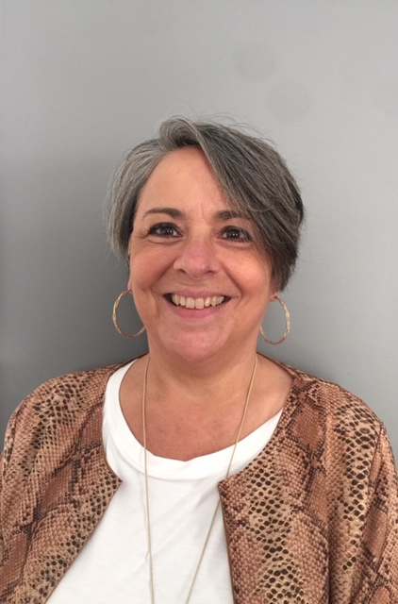
Meet your teacher Mrs. Elgaen
Notes:
Hello Kindergarten families this is Mrs. Elgaen your Kindergarten teacher this year. This year is going to be a fun adventure of learning. I can’t wait to meet you all!!

Slide 3
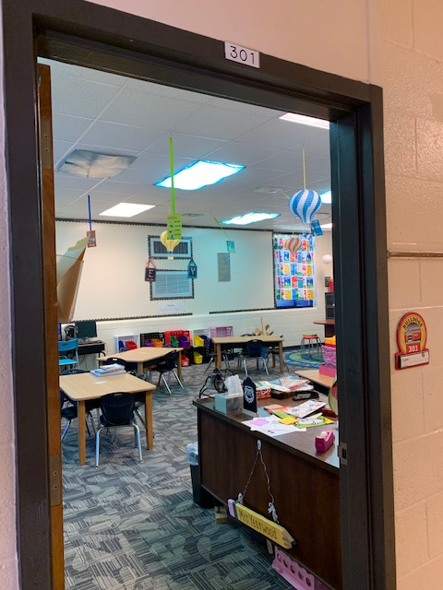
Notes:
A peek into Room 301 where your child will learn and grow! Most of our day will be spent in this room. We have it decorated in Dr. Seuss.

Slide 4
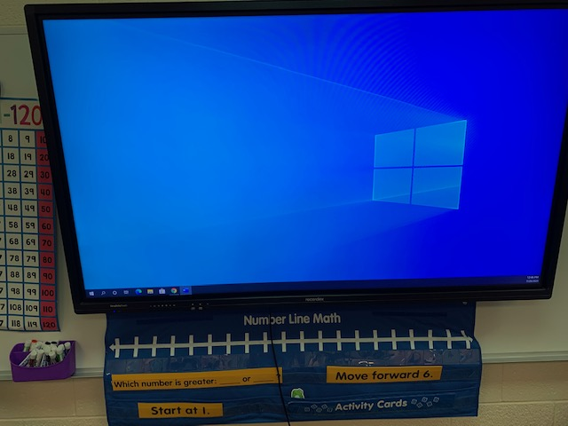
Notes:
One important part of our room is our Recordex board. On this board we listen to stories, read poems, exercise to GoNoodle, learn about science and do math.

Slide 5
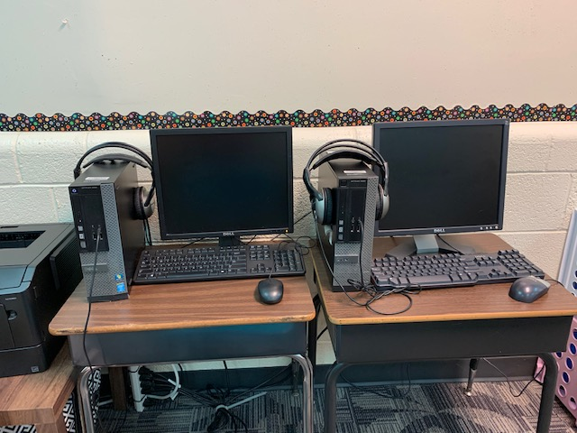
Notes:
In our classroom we have two desktop computers and 4 laptops. Students will use the computers to access iRead computer reading program and other educational websites.

Slide 6
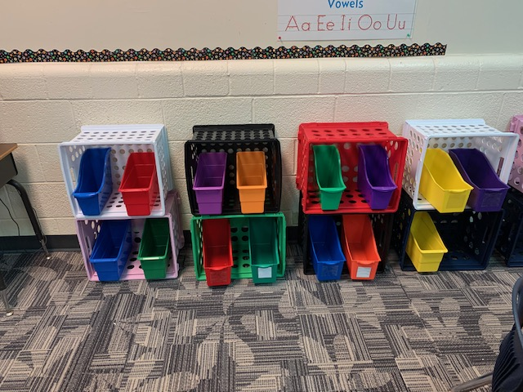
Notes:
This storage area is where your child will place their personal belongings such as notebooks and crayons.

Slide 7
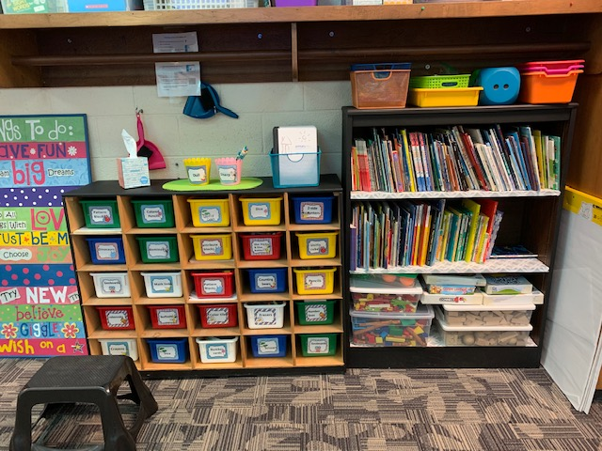
Notes:
The area on the right is where our math manipulatives are housed. These manipulatives will be placed in individual containers that only your child will handle. The right side are our classroom books. Students will be selecting books to place in their individual book bag that will become the books they read. Students will exchange the books perodically.

Slide 8
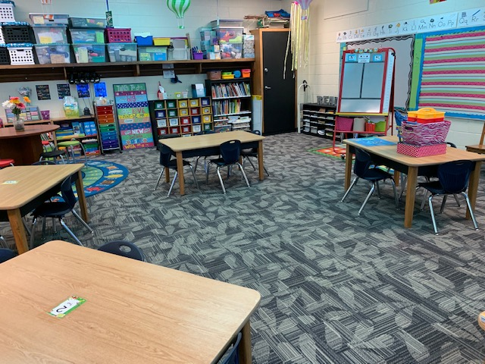
Notes:
This is an overall view of our room and the tables where your child will sit. This configuration will allow students to social distance, but yet still be a part of a group.

Slide 9
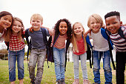
We are so excited to begin our school year!!

